Slide 1
Version 1.01
UCSD CSE 30
Computer Organization and Systems Programming
Numbers Data and Memory
Lecture 4 – Oct 4, 2022
Keith Muller
Cray XMP-1982

Slide 2

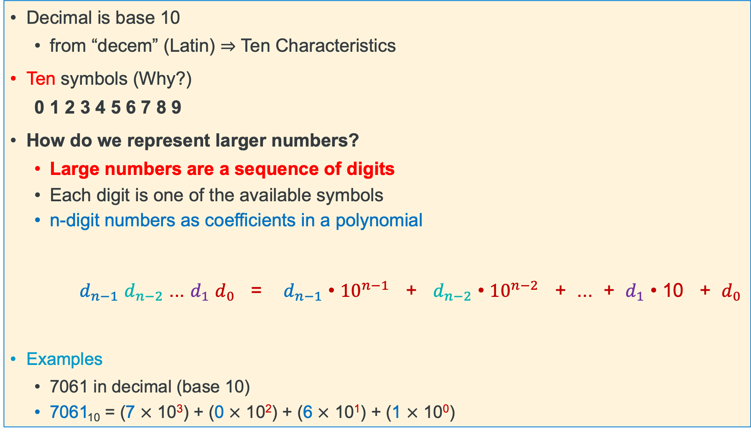
Review: Decimal Numbering
Decimal is base 10
from “decem” (Latin) ⇒ Ten Characteristics
Ten symbols (Why?)
0 1 2 3 4 5 6 7 8 9
How do we represent larger numbers?
Large numbers are a sequence of digits
Each digit is one of the available symbols
n-digit numbers as coefficients in a polynomial
$d_{n−1}$ $d_{n−2}$ ... $d_{1}$ $d_{0}$ = $d_{n−1}$ • ${10}^{n−1}$ + $d_{n−2}$ • ${10}^{n−2}$ + ... + $d_{1}$ • 10 + $d_{0}$
Examples
7061 in decimal (base 10)
7061₁₀ = (7 $×$ 10³) + (0 $×$ 10²) + (6 $×$ 10¹) + (1 $×$ 10⁰)
Digit position
symbol value
x

Slide 3

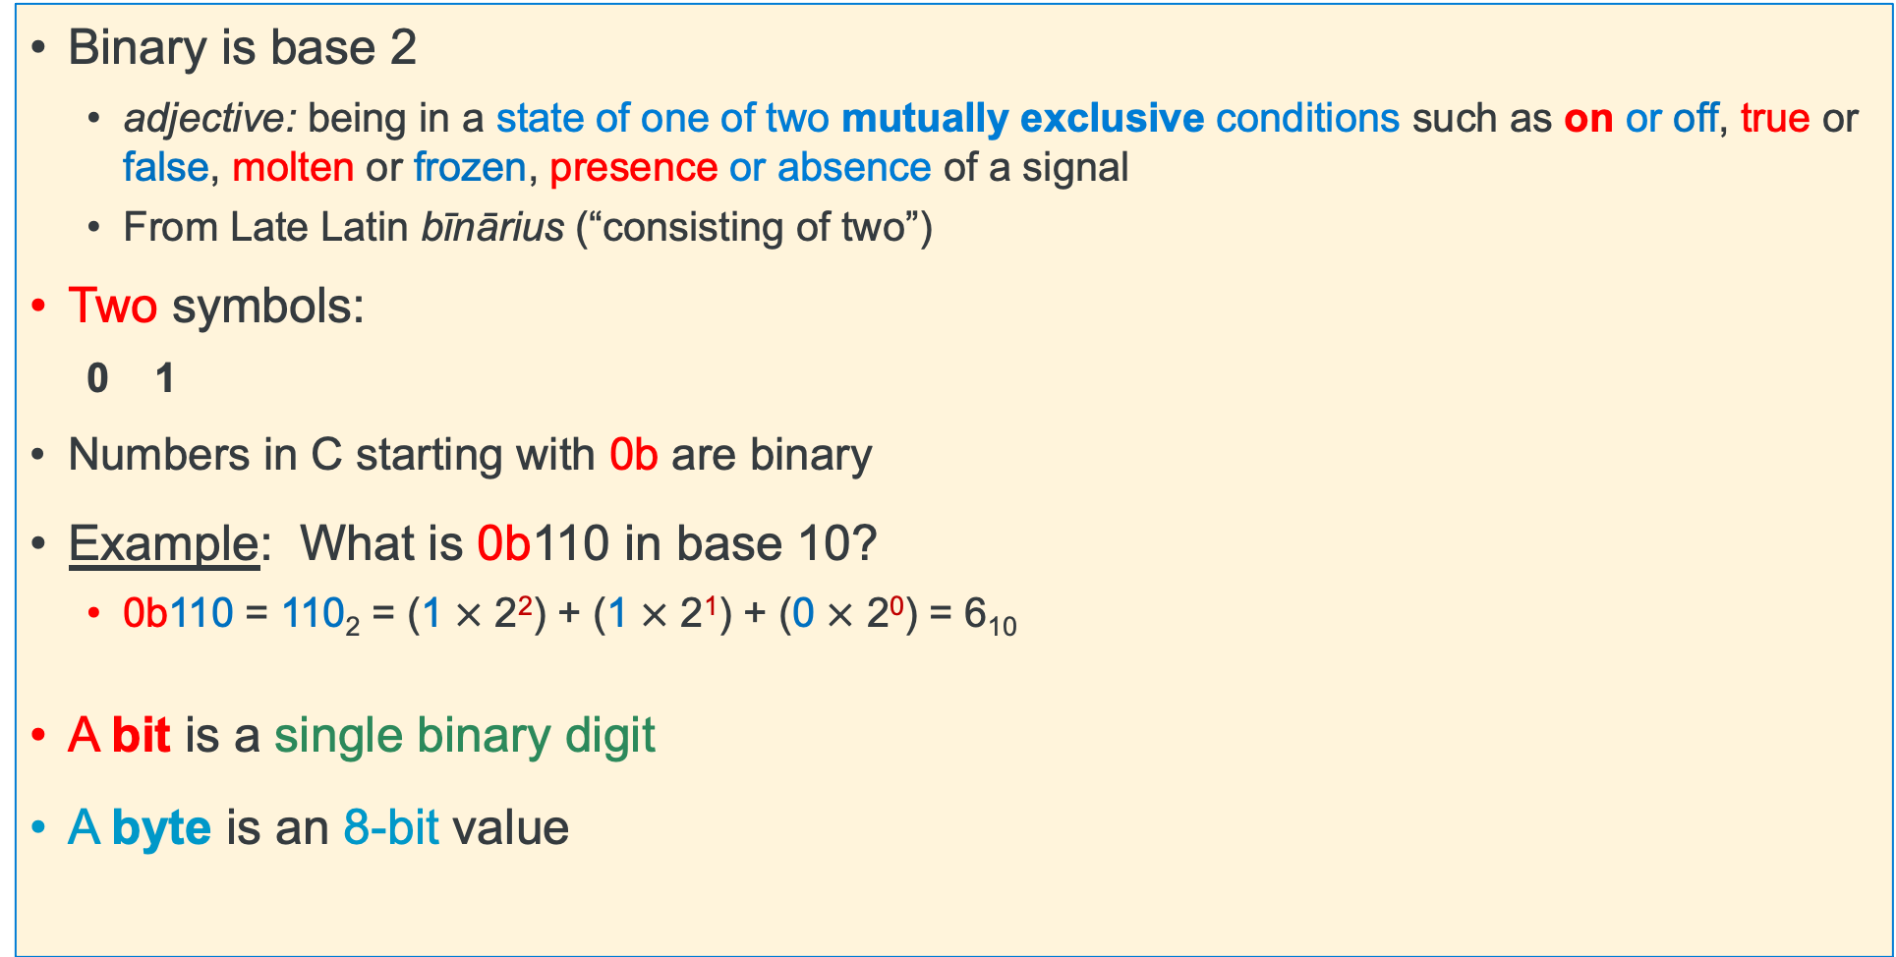
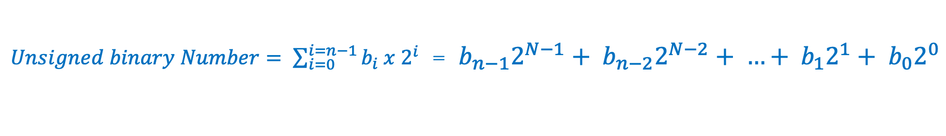
Review: Binary Numbering
Binary is base 2
adjective: being in a state of one of two mutually exclusive conditions such as on or off, true or false, molten or frozen, presence or absence of a signal
From Late Latin bīnārius (“consisting of two”)
Two symbols:
0 1
Numbers in C starting with 0b are binary
Example: What is 0b110 in base 10?
0b110 = 110₂ = (1 $×$ 2²) + (1 $×$ 2¹) + (0 $×$ 2⁰) = 6₁₀
A bit is a single binary digit
A byte is an 8-bit value
powers of two
$Unsigned binary Number= \sum_{i=0}^{i=n−1}{b_{i} x 2^{i}}$ = ${b_{n−1}2}^{N−1}+ {b_{n−2}2}^{N−2}+ …+ {b_{1}2}^{1}+ b_{0}2^{0}$
x

Slide 4


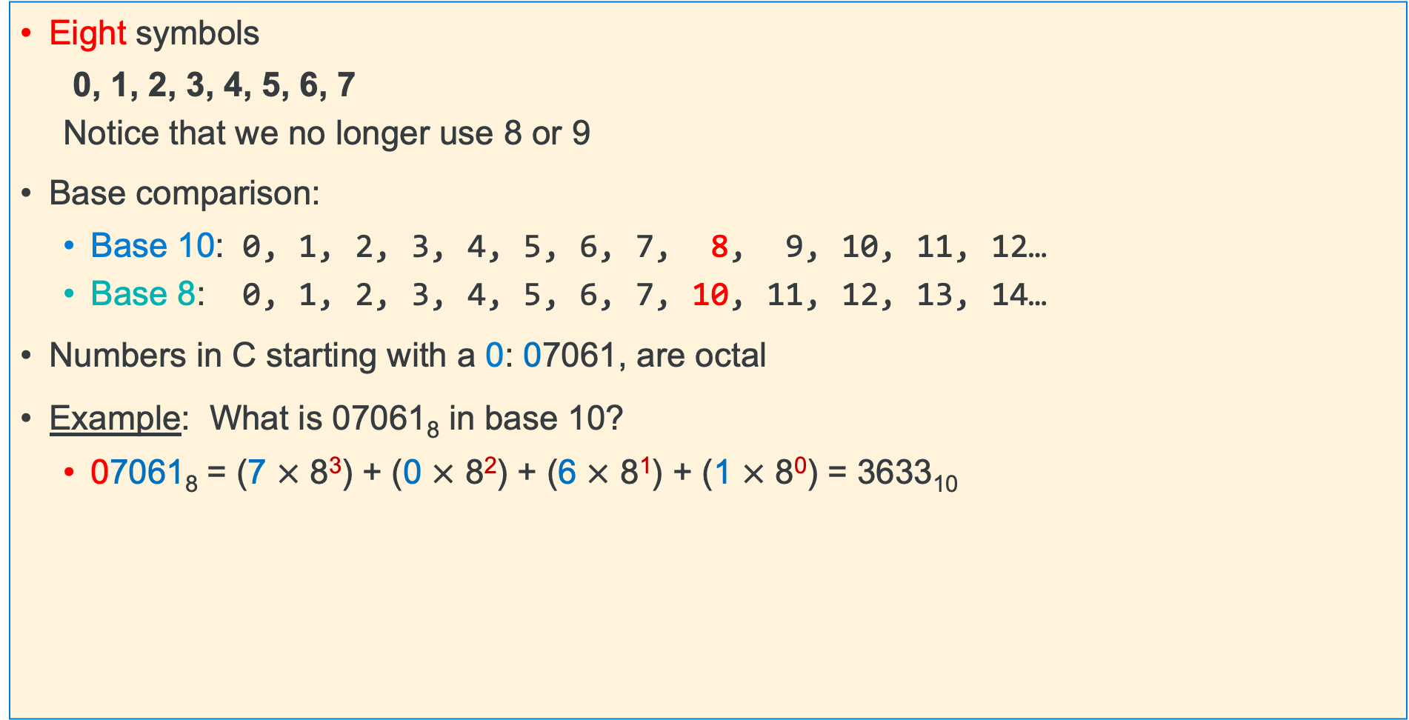
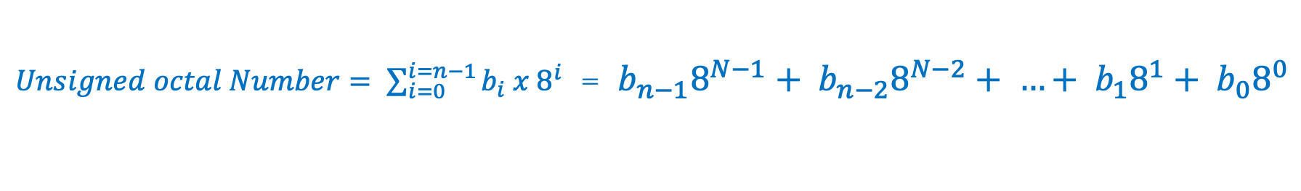
Review: Octal Numbering
Eight symbols
0, 1, 2, 3, 4, 5, 6, 7
Notice that we no longer use 8 or 9
Base comparison:
Base 10: 0, 1, 2, 3, 4, 5, 6, 7, 8, 9, 10, 11, 12…
Base 8: 0, 1, 2, 3, 4, 5, 6, 7, 10, 11, 12, 13, 14…
Numbers in C starting with a 0: 07061, are octal
Example: What is 07061₈ in base 10?
07061₈ = (7 $×$ 8³) + (0 $×$ 8²) + (6 $×$ 8¹) + (1 $×$ 8⁰) = 3633₁₀
powers of eight
subscript indicates base
in C leading 0 indicates octal
$Unsigned octal Number= \sum_{i=0}^{i=n−1}{b_{i} x 8^{i}}$ = ${b_{n−1}8}^{N−1}+ {b_{n−2}8}^{N−2}+ …+ {b_{1}8}^{1}+ b_{0}8^{0}$
x

Slide 5

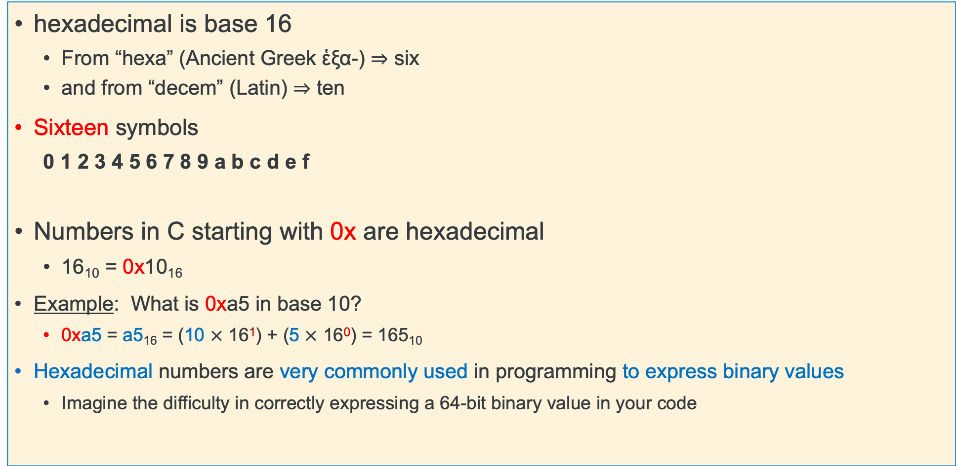
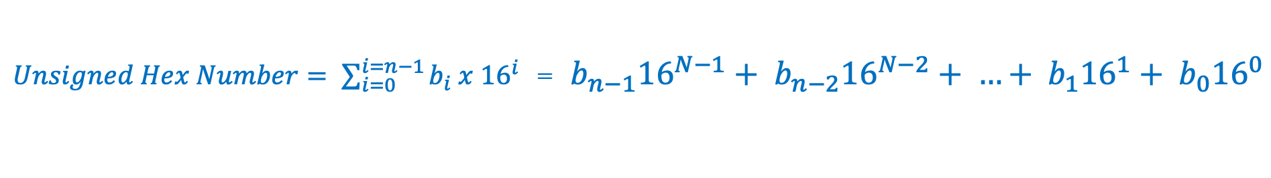
Review: Hexadecimal Numbering
hexadecimal is base 16
From “hexa” (Ancient Greek ἑξα-) ⇒ six
and from “decem” (Latin) ⇒ ten
Sixteen symbols
0 1 2 3 4 5 6 7 8 9 a b c d e f
Numbers in C starting with 0x are hexadecimal
16₁₀ = 0x10₁₆
Example: What is 0xa5 in base 10?
0xa5 = a5₁₆ = (10 $×$ 16¹) + (5 $×$ 16⁰) = 165₁₀
Hexadecimal numbers are very commonly used in programming to express binary values
Imagine the difficulty in correctly expressing a 64-bit binary value in your code
$Unsigned Hex Number= \sum_{i=0}^{i=n−1}{b_{i} x {16}^{i}}$ = ${b_{n−1}16}^{N−1}+ {b_{n−2}16}^{N−2}+ …+ {b_{1}16}^{1}+ b_{0}{16}^{0}$
x

Slide 6
Number Base Overview (as written in C)
Decimal is base 10, Hexadecimal is base 16, and octal is base 8
Octal digits have 8 values 0 – 7 (written in C as 00 – 07, careful 073 is octal = 59 in decimal)
Hex digits have 16 values 0 - 9 a - f (written in C as 0x0 – 0xf)
No standard prefix in C for binary (most use hex) – gcc (compiler) allows 0b prefix others might not
Hex digit Octal digit | 0x0 00 | 0x1 01 | 0x2 02 | 0x3 03 | 0x4 04 | 0x5 05 | 0x6 06 | 0x7 07
Decimal value | 0 | 1 | 2 | 3 | 4 | 5 | 6 | 7
Binary value | 0b0000 | 0b0001 | 0b0010 | 0b0011 | 0b0100 | 0b0101 | 0b0110 | 0b0111
Hex digit Octal digit | 0x8 010 | 0x9 011 | 0xa 012 | 0xb 013 | 0xc 014 | 0xd 015 | 0xe 016 | 0xf 017
Decimal value | 8 | 9 | 10 | 11 | 12 | 13 | 14 | 15
Binary value | 0b1000 | 0b1001 | 0b1010 | 0b1011 | 0b1100 | 0b1101 | 0b1110 | 0b1111
x

Slide 7
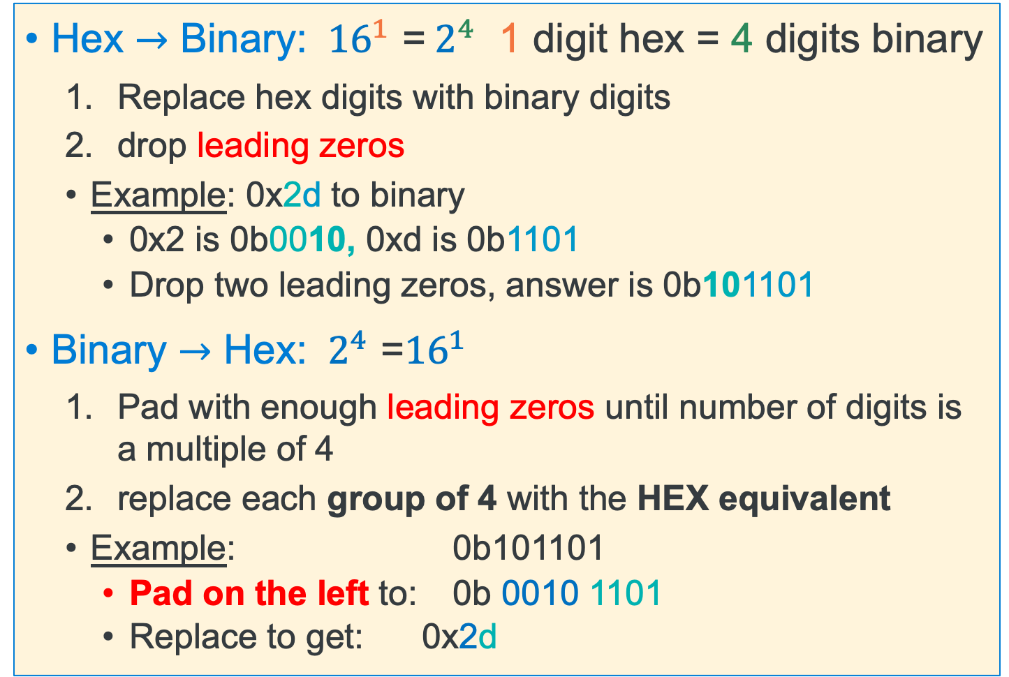
Binary <---> Hexadecimal Equivalences
Base 10 | Base 2 | Base 16
0 | 0000 | 0
1 | 0001 | 1
2 | 0010 | 2
3 | 0011 | 3
4 | 0100 | 4
5 | 0101 | 5
6 | 0110 | 6
7 | 0111 | 7
8 | 1000 | 8
9 | 1001 | 9
10 | 1010 | a
11 | 1011 | b
12 | 1100 | c
13 | 1101 | d
14 | 1110 | e
15 | 1111 | f
Hex $→$ Binary: ${ 16}^{1}$ =${ 2}^{4}$ 1 digit hex = 4 digits binary
Replace hex digits with binary digits
drop leading zeros
Example: 0x2d to binary
0x2 is 0b0010, 0xd is 0b1101
Drop two leading zeros, answer is 0b101101
Binary $→$ Hex: ${{ 2}^{4}\text{ =}16}^{1}$
Pad with enough leading zeros until number of digits is a multiple of 4
replace each group of 4 with the HEX equivalent
Example: 0b101101
Pad on the left to: 0b 0010 1101
Replace to get: 0x2d
x

Slide 8
Hex to Binary (group 4 bits per digit from the right)
Each Hex digit is 4 bits in base 2 ${ 16}^{1}$ =${ 2}^{4}$
0x f
a
5
3
1111 1010 0101 0011
0b1111101001010011
binary start with a 0b in C
x

Slide 9
Binary to Hex (group 4 bits per digit from the right)
4 binary bits is one Hex digit ${{ 2}^{4}\text{ =}16}^{1}$
0b 0110 1010 0011 1111
6
a
3
f
0x6a3f
hex start with 0x in C
x

Slide 10
Binary to Octal (group 3 bits per digit from the right)
3 binary bits is one Octal digit ${{ 2}^{3}\text{ =} 8}^{1}$
0b 0 110 101 000 111 111
0
6
5
0
7
7
065077
octal start with a 0 in C
x

Slide 11
Octal to Binary (group 3 bits per digit from the right)
One Octal digit is three binary digits ${{ 2}^{3}\text{ =} 8}^{1}$
01
7
5
1
2
3
1 111 101 001 010 011
0b1111101001010011
binary start with a 0b in C
x

Slide 12
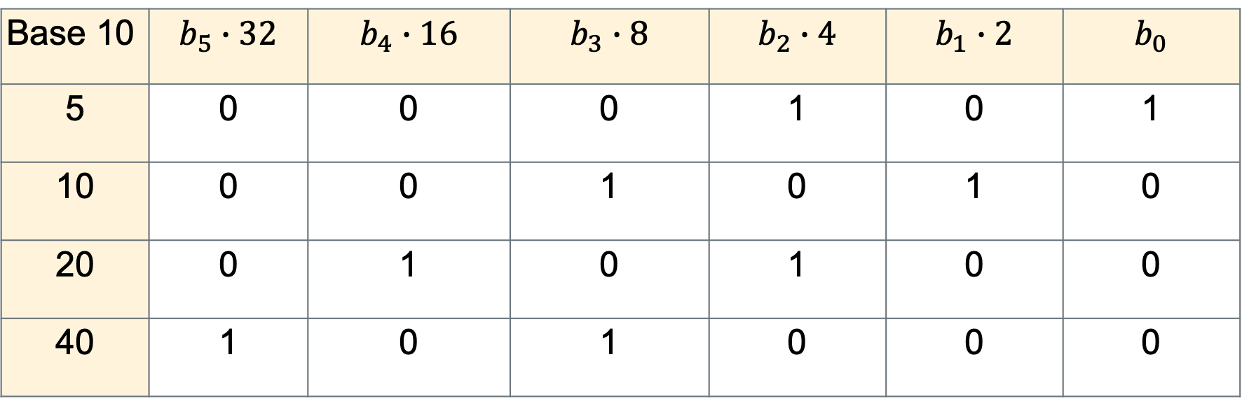
Looking at the Powers of Two
$Unsigned binary Number$= ${b_{n−1}2}^{N−1}+ {b_{n−2}2}^{N−2}+ …+ {b_{1}2}^{1}+ b_{0}2^{0}$
Base 10 | $$b_{5}∙32$$ | $$b_{4}∙16$$ | $$b_{3}∙8$$ | $$b_{2}∙4$$ | $$b_{1}∙2$$ | $$b_{0}$$
5 | 0 | 0 | 0 | 1 | 0 | 1
10 | 0 | 0 | 1 | 0 | 1 | 0
20 | 0 | 1 | 0 | 1 | 0 | 0
40 | 1 | 0 | 1 | 0 | 0 | 0
Multiple – left shift
Divide – right shift
x

Slide 13
Multiply By Base: Shift Left 1 digits = Multiply by 2
Binary
Most significant
Digit
Initial 8-digit Value
Least significant
Digit
0
3
0
0
7
0
0
2
Base 10
shift in 1 digits set to zero
Shift In
0
3
0
0
7
0
0
2
0
0
Throw away 1 digits
“bit bucket”
Truncate to Final 8-digit Value
x

Slide 14
Divide by Base: Shift Right 1 Digit = Divide by 2
Binary
Most significant
Digit
Initial 8-digit Value
Least significant
digit
0
7
0
0
9
0
0
4
Base 10
Shift In
0
0
0
7
0
0
9
0
0
4
shift in 1 zero
Carry Bit
“bit bucket”
Final 8-digit Value
x

Slide 15

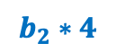
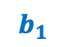
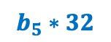

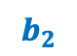
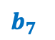
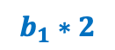



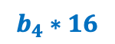
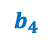
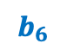
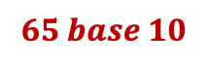
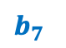
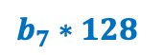
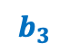
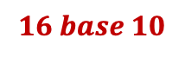

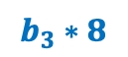
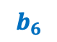
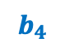
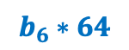


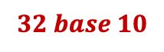
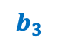
Use a Right Bit Shift: Unsigned Decimal To Unsigned Binary
Here is an Algorithmic approach to convert unsigned numbers to binary
Perform a sequence of divisions (right shift) to isolate the remainder
$$Unsigned binary Number = {b_{n−1}2}^{N−1}+ {b_{n−2}2}^{N−2}+…+ {b_{1}2}^{1}+ b_{0}2^{0}$$
$Unsigned Binary Number$ = $2 x (∙∙∙∙ (2 x (2 x{ b}_{n−1} + b_{n−2}$)$)$ +${∙∙∙∙+ b}_{1 }$) +${ b}_{0}$
0
1
0
0
0
0
0
1
$$65 base 10$$
$$b_{7}∗128$$
$$b_{6}∗64$$
$$b_{5}∗32$$
$$b_{4}∗16$$
$$b_{3}∗8$$
$$b_{2}∗4$$
$$b_{1}∗2$$
$$b_{0}∗1$$
$$b_{0}$$
$$shift in a zero →$$
0
0
1
0
0
0
0
0
1
$$32 base 10$$
$$b_{7}$$
$$b_{6}$$
$$b_{5}$$
$$b_{4}$$
$$b_{3}$$
$$b_{2}$$
$$b_{1}$$
$$remainder is bit 0$$
0
0
0
1
0
0
0
0
0
$$16 base 10$$
$$b_{7}$$
$$b_{6}$$
$$b_{5}$$
$$b_{4}$$
$$b_{3}$$
$$b_{2}$$
$$remainder is bit 1$$
x

Slide 16
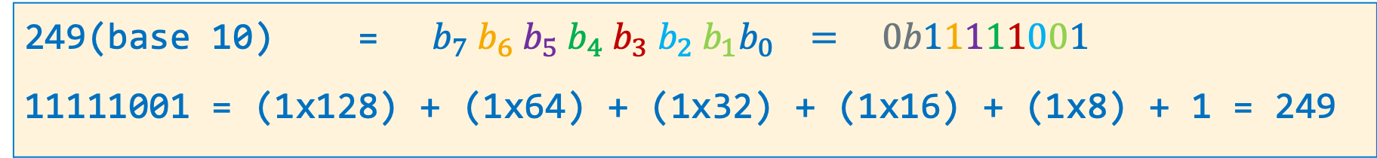
Unsigned Decimal to Unsigned Binary Conversion
dividend 249 | Quotient | Remainder | Bit Position
249/2 | 124 | 1 | b0
124/2 | 62 | 0 | b1
62/2 | 31 | 0 | b2
31/2 | 15 | 1 | b3
15/2 | 7 | 1 | b4
7/2 | 3 | 1 | b5
3/2 | 1 | 1 | b6
1/2 | 0 | 1 | b7
249(base 10) = ${ b}_{7}{ b}_{6}{ b}_{5}{ b}_{4}{ b}_{3}{ b}_{2}{{ b}_{1}b}_{0} = 0b11111001$
11111001 = (1x128) + (1x64) + (1x32) + (1x16) + (1x8) + 1 = 249
x

Slide 17
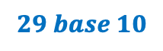
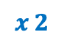

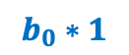

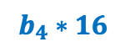

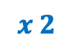
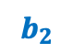
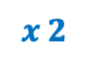
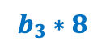
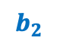
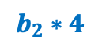
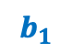

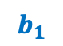
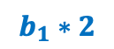


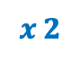
Left Bit Shift & add: Unsigned Binary to Unsigned Decimal
$$29 base 10$$
1
1
1
0
1
$$b_{4}∗16$$
$$b_{3}∗8$$
$$b_{2}∗4$$
$$b_{1}∗2$$
$$b_{0}∗1$$
Base conversion via a sequence of n multiplications (left shift) and n additions
111 base 2 -> ((1x2 + 1) x 2) + 1
Alternatively, you can memorize and use the positional weights to convert
(
1
+
1
)
1
0
1
0
$${b_{n−1}2}^{N−1}+ {b_{n−2}2}^{N−2}+…+ {b_{1}2}^{1}+ b_{0}2^{0}$$
$$x 2$$
$$b_{3}$$
$$b_{2}$$
$$b_{1}$$
$$b_{0}$$
(
3
+
1
)
0
1
0
0
$$x 2$$
$$b_{2}$$
$$b_{1}$$
$$b_{0}$$
(
7
+
0
)
1
0
0
0
$$x 2$$
$$b_{1}$$
$$b_{0}$$
(
14
+
1
)
0
0
0
0
$$x 2$$
$$b_{0}$$
29
+
0
0
0
0
0
11101 base 2 = (1 x 16) + (1 x 8) + (1 x 4) + (0 x 2) + (1 x 1) = 29
x

Slide 18
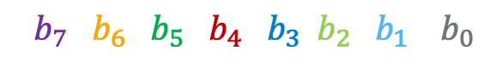
Unsigned Binary to Unsigned Decimal Conversion
What is 0 1 1 0 0 1 0 1(base 2) in decimal (N)?
101(base 10) = (1x64) + (1x32) + (1x4) + 1 (checking the conversion)
$${ b}_{7}{ b}_{6}{ b}_{5}{ b}_{4}{ b}_{3}{ b}_{2}{{ b}_{1} b}_{0}$$
Product Shift Left | Addend | Bit Position | Product
0 | + 0 | b7 | 0
2 x 0 = 0 (shift left) | + 1 | b6 | 1
2 x 1 = 2 | + 1 | b5 | 3
2 x 3 = 6 | + 0 | b4 | 6
2 x 6 = 12 | + 0 | b3 | 12
2 x 12 = 24 | + 1 | b2 | 25
2 x 25 = 50 | + 0 | b1 | 50
2 x 50 = 100 | + 1 | b0 | 101
x

Slide 19
Different Type of Numbers each have a Fixed # of Bits Spanning one or more contiguous bytes of memory
C Data Type | AArch-32 contiguous Bytes
char (arm unsigned) | 1
short int | 2
unsigned short int | 2
int | 4
unsigned int | 4
long int | 4
long long int | 8
float | 4
double | 8
long double | 8
pointer * | 4
Byte 8-bit integer uses 1 byte
00000000
7
0
Half Word 16-bit integer uses 2 bytes
000000001
00000000
15
7
0
most significant bit (largest power of 2)
least significant byte
Word 32-bit integer uses 4 bytes
00000011
00000010
00000001
00000000
31
0
most significant bit (smallest power of 2)
most significant byte
x

Slide 20
Variables: Size
Integer types
char, int
Floating Point
float, double
Modifiers for each base type
short [int]
long [int, double]
signed [char, int]
unsigned [char, int]
const: variable read only
char type
One byte in a byte addressable memory
Signed vs Unsigned Char implementations
Be careful char is unsigned on arm and signed on other HW like intel
C Data Type | AArch-32 contiguous Bytes | AArch-64 contiguous Bytes | printf specification
char (arm unsigned) | 1 | 1 | %c
short int | 2 | 2 | %hd
unsigned short int | 2 | 2 | %hu
int | 4 | 4 | %d / %i
unsigned int | 4 | 4 | %u
long int | 4 | 8 | %ld
long long int | 8 | 8 | %lld
float | 4 | 4 | %f
double | 8 | 8 | %lf
long double | 8 | 16 | %Lf
pointer * | 4 | 8 | %p
size of a pointer is the word size
x

Slide 21
Fixed size types in C
Sometimes programs need to be written for a particular range of integers or for a particular size of storage, regardless of what machine the program runs on
We will need to do this in PA3
In the file <stdint.h> the following fixed size types are defined for use in these situations:
Signed Data types | Unsigned Data types | Exact Size
int8_t | uint8_t | 8 bits (1 byte)
int16_t | uint16_t | 16 bits (2 bytes)
int32_t | uint32_t | 32 bits (4 bytes)
int64_t | uint64_t | 64 bits (8 bytes)
x

Slide 22
Example: Limits of Some Types on 32-bit ARM
type | Smallest | largest
unsigned char | 0 | 255
char (ARM - unsigned) | 0 | 256
char (INTEL - signed) | -128 | 127
unsigned short | 0 | 65,535
short | -32,768 | 32,767
uint32_t | 0 | 2^32 -1
int32_t | -2^31 | 2^31 -1
WARNING: If you want to force a char to be signed or unsigned use either
signed char or unsigned char
x

Slide 23
Watch out for Hardware differences: Example: Is a Char signed or unsigned?
#include <stdio.h>
#include <stdlib.h>
int
main(void)
{
char c = 255;
printf("%d\n", (int)c);
return EXIT_SUCCESS;
}
variable c is being cast promoted to an int
So, what is printed?
Depends on the hardware
Aarch32 and Aarch64 (arm) it is unsigned
255
Intel 64-bit it is signed
-1
x

Slide 24
sizeof(): Variable Size (number of bytes) Operator
#include <stddef.h>
/* size_t type may vary by system but is always unsigned */
sizeof() operator returns:
the number of bytes used to store a variable or variable type
size_t size = sizeof(variable_type);
or
size_t size = sizeof(variable_name); // preferred!
The argument to sizeof() is often an expression:
size = sizeof(int * 10);
reads as:
number of bytes required to store 10 integers (an array of [10])
x

Slide 25
sizeof() Examples (On the pi-cluster)
#include <stdio.h>
#include <stdlib.h>
int
main (void){
printf("char is %u\n", sizeof(char));
printf("short is %u\n",sizeof(short));
printf("int is %u\n", sizeof(int));
printf("long is %u\n", sizeof(long));
return EXIT_SUCCESS;
}
On 64-bit machines the %u should be %ul
% ./a.out (on the picluster)
char is 1
short is 2
int is 4
long is 4

Slide 26
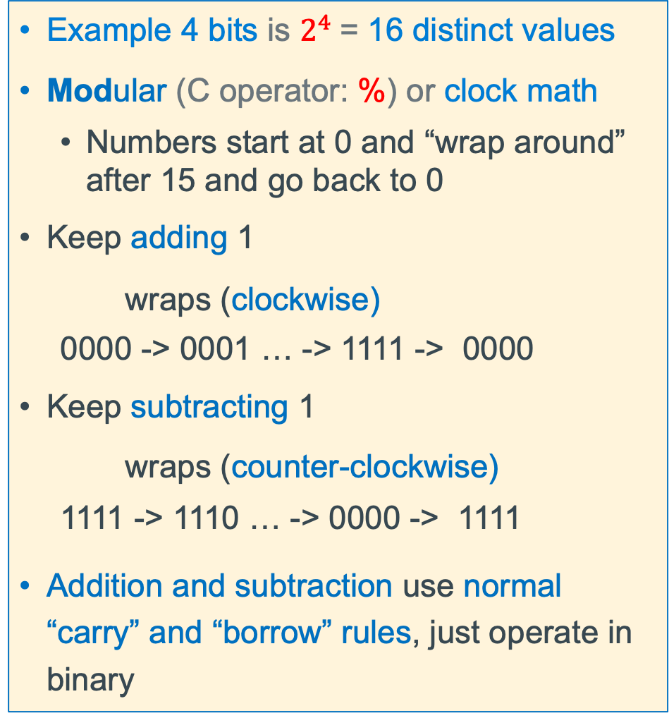
Unsigned Integers (positive numbers) with a Fixed # of Bits
Example 4 bits is $2^{4}$= 16 distinct values
Modular (C operator: %) or clock math
Numbers start at 0 and “wrap around” after 15 and go back to 0
Keep adding 1
wraps (clockwise)
0000 -> 0001 … -> 1111 -> 0000
Keep subtracting 1
wraps (counter-clockwise)
1111 -> 1110 … -> 0000 -> 1111
Addition and subtraction use normal “carry” and “borrow” rules, just operate in binary
x

Slide 27
Addition
Add two numbers in decimal
2 7 1 2
+ 2 0 + 7 8
4 7 9 0
+1 carry
Adding Single digits in binary
0 + 0 = 0
0 + 1 = 1
1 + 0 = 1
1 + 1 = 0 (with 1 carry) or 10 base 2
x

Slide 28
Unsigned Binary Number: Addition in FIXED 8 bits
Be Aware in Binary
1 + 1 = 10 base 10: (1 + 1 = 2)
1 + 1 + 1 = 11 base10: (1 + 1 + 1 = 3)
Carry Bit
carries
0
0
1
0
0
0
1
1
1 0 1 0 0 0 0 1
161
+
0 0 1 1 0 0 1 1
51
sum
1
1
0
1
0
1
0
0
212
x

Slide 29
Subtraction
Add two numbers in decimal
2 7 6 2
- 1 0 + 2 3
1 7 3 9
-1 borrow
+10 borrow
Subtracting Single digits in binary
0 - 0 = 0
0 - 1 = 1 (with a +2 (a 1) from the column to the left)
1 - 0 = 1
1 - 1 = 0
x

Slide 30
Unsigned Binary Number: Subtraction in FIXED 8 bits
borrows
1 0 1 0 0 0 0 1
161
-
-
0 0 1 1 0 0 1 1
51
difference
Be Aware in Binary
1 - 1 = 0
10 - 1 = 1 base 10: (2 – 1 = 1)
x

Slide 31
Unsigned Binary Number: Subtraction in FIXED 8 bits Build of previous slide – note warning
borrows
10
10
10
10
10
10
1
1 0 1 0 0 0 0 1
0
1
0
1
1
161
-
-
0 0 1 1 0 0 1 1
51
difference
0
1
1
0
1
1
1
0
110
NOTICE
This slide is performing the Subtraction shown in the previous slide using PowerPoint builds
when this slide is viewed in a pdf it will look incorrect
Be Aware in Binary
1 - 1 = 0
10 - 1 = 1 base 10: (2 – 1 = 1)
x

Slide 32
Unsigned Binary Multiplication example
a = 0 1 0 1 0 0 1 1 (83)
x b = 0 0 0 0 0 0 1 0 (2)
a = 0 1 0 1 0 0 1 1 (83)
0 0 0 0 0 0 0 0
0 1 0 1 0 0 1 1
x b = 0 0 0 0 0 1 0 1 (5)
0 1 0 1 0 0 1 1 0 (166)
0 1 0 1 0 0 1 1
0 0 0 0 0 0 0 0
0 1 0 1 0 0 1 1
0 1 1 0 0 1 1 1 1 1 (415!!)
Since we are multiplying by a power of two
we can shift left by 2 (zero insert at LSB)
a = 0 1 0 1 0 0 1 1 (83)
Exceeds what we can represent in 8 bits (255)
0 1 0 1 0 0 1 1 0 (166)
x

Slide 33
Unsigned Binary Number Divide
Consider 12/2 = 6
Consider 12/3 = 4
0
1
1
0
10
1 1 0 0
0
1
0
0
-0
11
1 1 0 0
1
1
-0
-1 0
1
1
1
0
-1 1
-1 0
0
0
0
0
-0 0
-0
0
0
0
-0 0
Since we are dividing by a power of two
we can shift right by 1 (zero insert at MSB)
0
1 1 0 0
0 1 1 0
drop (bit bucket)
x

Slide 34
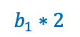
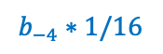
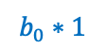
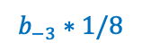


Fractional Binary Numbers
Binary | Decimal
2⁻¹ | 0.5
2⁻² | 0.25
2⁻³ | 0.125
2⁻⁴ | 0.0625
0
0
1
1
0
0
1
1
1
1
1
1
0
0
1
1
integer part
radix point
fractional part
“Binary Point,” like decimal point, signifies boundary between integer and fractional parts
Bits to right of “binary point” represent fractional powers of 2
Example: 10.1010₂ = 1×2¹ + 1×2⁻¹ + 1×2⁻³ = 2.625₁₀
xx.yyyy
2¹
2⁻⁴
2⁰
2⁻¹
2⁻²
2⁻³
$$b_{1}∗2$$
$$b_{0}∗1$$
$$b_{−1}∗1/2$$
$$b_{−2}∗1/4$$
$$b_{−3}∗1/8$$
$$b_{−4}∗1/16$$
1
0
1
1
0
0
x

Slide 35
Fixed Point Binary Number Divide
Consider 10/4 = 2.5
Consider 10/8 = 1.25
0
0
1
0
.1
0
0
0
1
.0 1
100
1 0 1 0 .0
1000
1 0 1 0 .0 0
-1 0 0
-1 0 0 0
0 1
0
0 1 0
0
-0 0 0
-0 0 0 0
1 0
0
1 0 0
0
-1 0 0
-1 0 0 0
0
0
x

Slide 36
Fixed Point Binary Number Limitations
Limitation #1
Can only exactly represent numbers of the form x/2^{k}
Other rational numbers have repeating bit representations
Value Representation
1/3 0.0101010101[01]…2
1/5 0.001100110011[0011]…2
1/10 0.0001100110011[0011]…2
Limitation #2
Just one setting of binary point within the w bits
Limited range of numbers (very small values? very large?)
x

Slide 37

Overflow: Going Past the Boundary Between max and min
max
min
Overflow: Occurs when an arithmetic result (from addition or subtraction for example) is is more than min or max limits
Example shown is for a 4-bit number
C (and Java) ignore overflow exceptions
You end up with a bad value in your program and absolutely no warning or indication… happy debugging!….
x

Slide 38
Unsigned Integer Number Overflow: Addition in 8 bits
Carry
Bit
carries
1
1
1
1
1
1
1
1
only 8 bits for numbers in this example carry bit is always dropped from result
1 0 1 0 0 0 0 1
161
+
0 1 0 1 1 1 1 1
95
sum
0
0
0
0
0
0
0
0
256
Rule: When Carry Bit != 0, overflow has occurred for unsigned integers!
x

Slide 39

Unsigned Integers (positive numbers) with a Fixed # of Bits
Example 4 bits is $2^{4}$= 16 distinct values
Modular (C operator: %) or clock math
Numbers start at 0 and “wrap around” after 15 and go back to 0
Keep adding 1
wraps (clockwise)
0000 -> 0001 … -> 1111 -> 0000
Keep subtracting 1
wraps (counter-clockwise)
1111 -> 1110 … -> 0000 -> 1111
Addition and subtraction use normal “carry” and “borrow” rules
x

Slide 40
Overflow: Unsigned Values 4-bit limit
Overflow: Occurs when an arithmetic result is exceeds the min or max limits
Addition Overflow: hardware drops carry
Subtraction Overflow: drops the borrow
15
+ 2
17
only 4 bits for numbers in this example
carry bit is always dropped from result
1111
+ 0010
10001
oops 1
UMAX
UMIN
15
0
14
1111
0000
1
13
1110
0001
2
1101
0010
12
3
1
- 2
-1
only 4 bits for numbers in this example
carry bit is always dropped from result
1100
0011
10001
- 0010
1111
oops 15
Unsigned
11
1011
0100
4
1010
0101
10
1001
0110
5
9
1000
0111
6
8
7
x

Slide 41












Problem: How to Encode Both Positive and Negative Integers
How do we represent the negative numbers within a fixed number of bits?
Allocate some bit patterns to negative and others to positive numbers (and zero)
$2^{n}$ distinct bit patterns to encode positive and negative values
Unsigned values: 0 ... $2^{n}$–1
Signed values: $−2^{n−1}$ … $2^{n−1}$–1 (dividing the range in ~ half including 0)
On a number line (below): 8-bit integers – signed and unsigned (e.g., char in C)
-1 comes from counting 0 as a "positive" number
$$0$$
Unsigned
$+2^{8}$-1
-$∞$
+$∞$
$$−128$$
$$0$$
$$+127$$
$$+255$$
$${−2}^{8−1}$$
$$0$$
Signed
${+2}^{8−1}$-1
Same “width” (same number of encodings), just shifted in value
x

Slide 42
Negative Integer Numbers: Sign + Magnitude Method
these numbers show bit position boundaries
31
30
0
Sign bit
Remaining bits
MSB
LSB
Use the Most Significant Bit as a sign bit
0 as the MSB represents positive numbers
1 as the MSB represents negative numbers
Two (oops) representations for zero: 0000, 1000
Tricky Math (must handle sign bit independently)
With Simple math, Positive and Negatives “increment” (+1) in the opposite directions!
4 - 3 1
0100 - 0011 0001
4 + -3 -7
0100 + 1011 1111
✓
✗
x

Slide 43
1's Complement Signed Integer Method
Use the MSB is the sign bit to represent a negative value is encoded as the 1's complement
All negative values have a one in the leftmost bit
All positive values have a zero in the leftmost bit
The problem is there are two values for zero
1111 and 0000 in 4-bits
arithmetic is tricky when you cross over the zeros
Number | + | -
0 | 0000 | 1111
1 | 0001 | 1110
2 | 0010 | 1101
3 | 0011 | 1100
4 | 0100 | 1011
5 | 0101 | 1010
6 | 0110 | 1001
7 | 0111 | 1000
-7
-2
-1
-0
0
1
2
7
x

Slide 44

2's Complement Signed Integer Method
Positive numbers encoded same as unsigned numbers
All negative values have a one in the leftmost bit
All positive values have a zero in the leftmost bit
This implies that 0 is a positive value
Only one zero
For n bits, Number range is${ −(2}^{n−1}$) to ${ +(2}^{n−1}$ - 1)
Negative values “go further” than the positive values
Example: the range for 8 bits: -128, -127, .. 0, .. 126, +127
Example the range for 32 bits: -2147483648 .. 0, .. +2147483647
Arithmetic is the same as with unsigned binary!
x

Slide 45


Two’s Complement: The MSB Has a Negative Weight
$$2^{′}s Comp={{−b}_{n−1}2}^{n−1}+ {b_{n−2}2}^{n−2}+ …+ {b_{1}2}^{1}+ b_{0}2^{0}$$
$b_{n−1}$ weight is $(−2^{n−1}$), all other bits: have positive weights $(+2^{i}$)
b_{n-1}
b_{n-2}
. . .
b₀
4-bit (w = 4) weight = $−2^{4−1}$ = -2³ = -8
1010₂ unsigned: 1x2³ + 0x2² + 1x2¹ + 0x2⁰ = 10
1010₂ two’s complement: -1x2³ + 0x2² + 1x2¹ + 0x2⁰ = -8 + 2 = –6
-8 in two’s complement: 1000₂ = -2³ + 0 = -8
-1 in two’s complement: 1111₂ = -2³ + (2³ – 1) = -8 + 7 = -1
x

Slide 46

Summary: Min, Max Values: Unsigned and Two’s Complement
Two’s Complement $→$ Unsigned for n bits
Unsigned Value Range
UMin = 0b00…00 = $0$
UMax = 0b11…11 = $2^{n}−1$
Two’s Complement Range
SMin = 0b10…00 = $−2^{n−1}$
SMax = 0b01…11 = $2^{n−1}−1$
For n=4
x

Slide 47
Negation Of a Two’s Complement Number (Method 1)
7 = 0111
invert = 1000
add 1 + 1
-7 1001
-7 = 1001
invert = 0110
add 1 + 1
7 0111
-x == ~x + 1;
7 = 0111
-7 = + 1001
(discard carry) 0000
1 = 0001
invert = 1110
add 1 + 1
-1 1111
-1 = 1111
invert = 0000
add 1 + 1
1 0001
-8 = 1000
invert = 0111
add 1 + 1
-8 1000 oops!
x

Slide 48
Negation of a Two’s Complement Number (Method 2)
copy unchanged right most bit containing a 1 and all the 0's to its right
Invert all the bits to the left of the right-most 1
7 =
0 1 1
1
4 =
0
1 0 0
0 =
0 0 0 0
invert
Copy
invert
Copy
Copy
-7 =
1 0 0
1
-4 =
1
1 0 0
0 =
0 0 0 0
56 =
0 0 1 1
1 0 0 0
-8 =
1 0 0 0
invert
Copy
Copy
OOPS!
-56 =
1 1 0 0
1 0 0 0
-8 =
1 0 0 0
x

Slide 49

Signed Decimal to Two's Complement Conversion
dividend -102 | Quotient | Remainder | Bit Position
102/2 | 51 | 0 | b0
51/2 | 25 | 1 | b1
25/2 | 12 | 1 | b2
12/2 | 6 | 0 | b3
6/2 | 3 | 0 | b4
3/2 | 1 | 1 | b5
1/2 | 0 | 1 | b6
0/2 | 0 | 0 | b7
102(base 10) = ${ b}_{7}{ b}_{6}{ b}_{5}{ b}_{4}{ b}_{3}{ b}_{2}{{ b}_{1}b}_{0} = 0b0110 0110$
Get the two complement of 01100110 is 10011010
x

Slide 50

Two's Complement to Signed Decimal Conversion - Positive
What is 0 1 1 0 0 1 0 1(base 2) in decimal (N)?
$${ b}_{7}{ b}_{6}{ b}_{5}{ b}_{4}{ b}_{3}{ b}_{2}{{ b}_{1} b}_{0}$$
Signed Bit Bias | Bit | Bit Position | Bias
-2^{W-1} = -2⁸⁻¹ = -128 | x 0 | b7 | 0
Product Shift Left | Addend | Bit Position | Product
2 x 0 = 0 (shift left) | + 1 | b6 | 1
2 x 1 = 2 | + 1 | b5 | 3
2 x 3 = 6 | + 0 | b4 | 6
2 x 6 = 12 | + 0 | b3 | 12
2 x 12 = 24 | + 1 | b2 | 25
2 x 25 = 50 | + 0 | b1 | 50
2 x 50 = 100 | + 1 | b0 | SUM = 101
 |  | Bias + SUM: | 0 + 101 = 101
x

Slide 51

Two's Complement to Signed Decimal Conversion - Negative
What is 1 1 1 0 0 1 0 1(base 2) in decimal (N)?
$${ b}_{7}{ b}_{6}{ b}_{5}{ b}_{4}{ b}_{3}{ b}_{2}{{ b}_{1} b}_{0}$$
Signed Bit Bias | Bit | Bit Position | Bias
-2^{W-1} = -2⁸⁻¹ = -128 | x 1 | b7 | -128
Product Shift Left | Addend | Bit Position | Product
2 x 0 = 0 (shift left) | + 1 | b6 | 1
2 x 1 = 2 | + 1 | b5 | 3
2 x 3 = 6 | + 0 | b4 | 6
2 x 6 = 12 | + 0 | b3 | 12
2 x 12 = 24 | + 1 | b2 | 25
2 x 25 = 50 | + 0 | b1 | 50
2 x 50 = 100 | + 1 | b0 | SUM = 101
 |  | Bias + SUM: | -128 + 101 = -27
x

Slide 52
Two’s Complement Addition and Subtraction
Addition: just add the two number directly
Subtraction: you can convert to addition: difference = minuend – subtrahend
difference = minuend + 2’s complement (subtrahend)
x = 0 1 0 1 0 0 1 1
y = 0 0 0 0 1 0 1 1
Cout
0 0 0 0 0 0 1 1
x-y = 0 1 0 0 1 0 0 0
x = 0 1 0 1 0 0 1 1
y = 0 0 0 0 1 0 1 1
`
x + y = 0 1 0 1 1 1 1 0
2’s complement first and then add
+ (-y) = 1 1 1 1 0 1 0 1
x = 0 1 0 1 0 0 1 1
x – y = x +(-y) = 0 1 0 0 1 0 0 0
x

Slide 53
Two’s Complement Overflow Detection - 1
– 1
0
– 2
1111
0000
+ 1
– 3
1110
0001
+ 2
When adding two positive numbers or two negative numbers
4-bit Two’s complement numbers (positive overflow)
1101
0010
– 4
+ 3
1100
Two’s Complement
0011
– 5
1011
0100
+ 4
1010
0101
Cout
0
Cin
1
– 6
1001
0110
+ 5
0
0
1000
0111
0 1 0 1 5
+ 0 1 1 0 6
– 7
+ 6
– 8
+ 7
SMIN
SMAX
1 0 1 1 -5 != 11
Overflow: Occurs when an arithmetic result is beyond the min or max limits
x

Slide 54
Two’s Complement Overflow Detection - 2
– 1
0
– 2
1111
0000
+ 1
When adding two positive numbers or two negative numbers
4-bit Two’s complement numbers (negative overflow)
– 3
1110
0001
+ 2
1101
0010
– 4
+ 3
1100
Two’s Complement
0011
– 5
1011
0100
+ 4
Cout
1
Cin
0
1
1
1010
0101
carry bit is dropped from result
1 0 0 1 -7
+ 1 0 1 1 -5
– 6
1001
0110
+ 5
– 7
1000
0111
+ 6
0 1 0 0 +4 != -12
– 8
+ 7
SMIN
SMAX
signed numbers: overflow occurs if
operands have same sign and result’s sign is different
Overflow: Occurs when an arithmetic result is beyond the min or max limits
x

Slide 55
Summary: When Does Overflow Occur
Operand 1
+ Operand 2
Result
Operand 1 Sign | Operand 2 Sign | Is overflow Possible?
+ | + | YES
- | - | YES
+ | - | NO
- | + | NO
x

Slide 56
Scientific Notation Binary
mantissa
exponent
+1.01₂ × 2⁻¹
sign
binary point
radix (base)
Computer hardware that supports this is called floating point hardware due to the “floating” of the binary point
Declare such variable in C as float (or double)
x

Slide 57
Floating Point Representation
Analogous to scientific notation
In Decimal:
Not 12000000, but 1.2 x 10⁷ In C: 1.2e7
Not 0.0000012, but 1.2 x 10⁻⁶ In C: 1.2e-6
In Binary:
Not 11000.000, but 1.1 x 2⁴
Not 0.000101, but 1.01 x 2⁻⁴
x

Slide 58

Normalized Scientific Notation
Convert from scientific notation to fixed binary point
Perform the multiplication by shifting the decimal until the exponent disappears
Example: 1.011₂$×$ 2⁴ = 10110₂ = 22₁₀
Example: 1.011₂$×$ 2⁻² = 0.01011₂ = 0.34375₁₀
Convert from binary point to normalized scientific notation
Distribute out exponents until binary point is to the right of a single digit
Example: 1101.001₂ = 1.101001₂ x 2³
Binary | Decimal
2⁻¹ | 0.5
2⁻² | 0.25
2⁻³ | 0.125
2⁻⁴ | 0.0625
x

Slide 59
Encoding Fractions Observations
In Base 2:
10.1 x 2⁵ = 1.01 x 2⁶
1011.1 x 2⁵ = 1.0111 x 2⁸
0.110 x 2⁵ = 1.10 x 2⁴
Normalizing with base 2 :
adjust so there always a 1 to the left of the decimal point!
this 1 is called the hidden bit as we do not have use a bit to store it since it is there in every normalized mantissa
Adjust x to always be in the format 1.XXXXXXXXX… (fraction is normalized)
Fraction portion ONLY encodes what is to the right of the decimal point
“Hidden bit” allows number to have One additional digit for increased precision
Fraction encoding is 1.[FRACTION BINARY DIGITS]
x

Slide 60

Floating Point Numbers: Implementation Approach
Supports a wide range of numbers
Flexible “floating” decimal point
Represent scientific notation numbers like 1.202 x ${10}^{6}$
(–1)^{s} M 2E
S
E
M
sign bit
exponent
fraction
Sign bit (a single bit): 0 positive, 1 negative
Exponent: encoding of E above (it is NOT E directly represented in binary)
Fraction: encoding of M above (it is NOT M directly represented in binary)
x

Slide 61
Floating Point Number in a Byte (Not A Real Format)
S = 1 bit
7
6
E = 3 bits
4
3
M = 4 bits
0
sign bit
exponent
fraction
1 byte = 8 bits total
Mantissa encoding: = 1.[xxxx] encoded as an unsigned value
4 bits = 16 values + leading digit is always a 1
Exponent encoding: 3 bits encoded to represent both – and + exponents
x

Slide 62

IEE 754 Floating Point
sign | Exp = E +127 | mantissa
1 | 8 | 23
sign | Exp = E + 1023 | mantissa
1 | 11 | 52
Evolving Standard
Single – 32 bit "C Float"
Double – 64 bit "C Double"
Half – 16 bit
Quad – 128 bit
Binary Floating Point
Standard also defined decimal FP (not supported by most hardware)
Special Encodings
NAN – not a number (quiet, signaling)
+$∞$ and -$∞$ (biggest positive #, and smallest negative number)
Subnormal Numbers
x

Slide 63
Floating Point and Linearity
Exp=000
Exp=001
Exp=010
Exp=011
Exp=100
Why the non-linearity?
Note, Exp=000 is treated specially
x

Slide 64
IEEE Floating Point and "C" FP Types
IEEE Type | size | sign | exponent | mantissa | “C” name
bfloat (not IEEE yet) | 16 | 1 | 8 | 7 | (subset of float)
half | 16 | 1 | 5 | 10
single | 32 | 1 | 8 | 23
double | 64 | 1 | 11 | 52
quad | 128 | 1 | 15 | 112
x

Slide 65
Memory Review: Organized in Units of Bytes
n-bit Memory
Address
One bit (digit) of storage (in memory) has two possible states: 0 or 1
Memory is organized into a fixed unit of 8 bits, called a byte
Conceptually, memory is a single, large array of bytes, where each byte has a unique address (byte addressable memory)
An address is an unsigned (positive #) fixed-length n-bit binary value
Range (domain) of possible addresses = address space
Each byte in memory can be individually accessed and operated on given its unique address
Memory
contents
High address
..00000111
10101010
Bit position in Byte
7 | 6 | 5 | 4 | 3 | 2 | 1 | 0
0 | 0 | 1 | 0 | 0 | 0 | 0 | 0
Content of each bit
01010101
..00000110
MSB
Most Significant Bit
LSB
(Least Significant Bit)
..00000101
10101010
..00000100
01010101
..00000011
10101010
..00000010
01010101
..00000001
10101010
..00000000
01010101
Low address
1 byte
(8-bits wide)
x

Slide 66

Memory Size
Since memory addresses are implemented in hardware using binary
The Size (number of byte sized cells) of Memory is specified in powers of 2
Memory size/capacity in bytes is specified by the “Number of bits" in an address
32 bits of address = 2³² ⁼ 4,294,967,296
Address Range is 0 to 2³² – 1 (unsigned)
Shorthand notation for address size (Memory Capacity)
KB = 2¹⁰ (K=1024) kilobyte
MB = 2²⁰ megabyte
GB = 2³⁰ gigabyte
TB = 2⁴⁰ terabyte
PB = 2⁵⁰ petabyte
Memory dimm
Address Bits
Data Bits
Data Bits
x

Slide 67
Variables in Memory: Size and Address
The number of contiguous bytes a variable uses is based on the type of the variable
Different variable types require different numbers of contiguous bytes
Variable names map to a starting address in memory
Example Below: Variables all starting at address 0x80
memory
int
4 bytes
memory
short int
2 bytes
83
00000000
memory
char
82
11111111
10101010
Size in bytes
81
81
10101010
Start
Size in bytes
Start
80
01010101
Start
80
01010101
80
01010101
x

Slide 68
Address and Pointers
32-bit address
(hex)
An address refers to a location in memory, the lowest or first byte in a contiguous sequence of bytes
A pointer is a variable whose contents (or value) can be properly used as an address
The value in a pointer should be a valid address allocated to the process by the operating system
The variable x is at memory address 0x00001008
The variable pt is at memory location 0x00001000
The contents of pt is the address of x 0x00001008
(1 Byte)
0x0000100F
0x0000100E
0x0000100D
0x0000100C
00
0x0000100B
00
0x0000100A
int x =
0x77; ------>
00
0x00001009
77
0x00001008
0x00001007
0x00001006
0x00001005
0x00001004
00
0x00001003
00
0x00001002
01
0x00001001
pt is a pointer to x------>
08
0x00001000
x

Slide 69
Byte Ordering of Numbers In Memory: Endianness
Two different ways to place multi-byte integers in a byte addressable memory
Big-endian: Most Significant Byte (“big end”) starts at the lowest (starting) address
Little-endian: Least Significant Byte (“little end”) starts at the lowest (starting) address
Example: 32-bit integer with 4-byte data
Little-Endian
Big-Endian
a1
b2
c3
d4
23
0x103
23
0x103
d4
a1
01
0x102
01
0x102
c3
MSB
Most significant byte
LSB
Least significant byte
b2
c3
0x101
b2
0x101
d4
0x100
a1
0x100
x

Slide 70
Byte Ordering Example
Decimal: 12345
Binary: 0011 0000 0011 1001
Hex: 3 0 3 9
int x = 12345;
// or x = 0x3039;
(big-endian)
IA32, ARM32 (little-endian)
0x03
39
00
0x03
0x02
30
00
0x02
0x01
00
30
0x01
0x00
00
39
0x00
x

Slide 71
Extra Slides

Slide 72
Floating Point Number in a Byte (Not A Real Format)
S = 1 bit
7
6
E = 3 bits
4
3
M = 4 bits
0
sign bit
exponent
fraction
1 byte = 8 bits total
Mantissa encoding: = 1.[xxxx] encoded as an unsigned value
Exponent encoding: 3 bits encoded as an unsigned value using bias encoding
Bias encoding = (2^{E-1} – 1)
3 bits for the bias we have 2³⁻¹ - 1 = 2² - 1 = a bias of 3
With a Bias of 3: positive and negative numbers range: small to large is: 2⁻³ to 2⁴
Actual | -3 | -2 | -1 | 0 | 1 | 2 | 3 | 4
Bias | + 3 | + 3 | + 3 | + 3 | + 3 | + 3 | + 3 | +3
Biased | 0 | 1 | 2 | 3 | 4 | 5 | 6 | 7
x

Slide 73
Encoding Fractions Observations
Examples In Base 10:
42.4 x 10⁵ = 4.24 x 10⁶
324.5 x 10⁵ = 3.245 x 10⁷
0.624 x 10⁵ = 6.24 x 10⁴
Observation on base 10:
We usually adjust the exponent until we get down to one digit to the left of the decimal point
x

Slide 74
Characteristics of Signed Numbers
Digital Hardware (and C) supports two flavors of integers
unsigned – only non-negative (positive) numbers
signed – both negative and non-negatives (positive) numbers
A Signed integer must be able to represent:
Negative integer
Zero (0)
Positive Integer
number + (- representation of number) = 0
So, with a fixed number of bits, some of the bit patterns in the wheel at the left must be reallocated to represent negative numbers
15
0
14
1111
0000
1
13
1110
0001
2
1101
0010
12
1100
0011
3
11
1011
0100
4
1010
0101
10
1001
0110
5
9
1000
0111
6
8
7
x

Slide 75
Sign Extension in C: Type casts
Convert from smaller to larger integral data types
C and Java automatically performs sign extension
Example (remember we are working with 32-bit int and 16-bit short)
short int sx = 12345;
int ix = (int) sx;
0b0011
Var | Decimal | Hex | Binary
sx | 12345 | 30 39 | 00110000 00111001
ix | 12345 | 00 00 30 39 | 00000000 00000000 00110000 00111001
short int sy = -12345;
int iy = (int) sy;
0b1100
Var | Decimal | Hex | Binary
sy | -12345 | CF C7 | 11001111 11000111
iy | -12345 | FF FF CF C7 | 11111111 11111111 11001111 11000111
x

Slide 76
Shift Operations in C
n is number of bits to shift a variable x of width w bits
Shifts by n < 0 or n ≥ w are undefined
Left shift (x << N)
Shift N bits left, Fill with 0s on right
In C: behavior of >> is determined by compiler
gcc: it depends on data type of x (signed/unsigned)
Right shift (x >> N)
Logical shift (for unsigned variables)
Shift N bits right, Fill with 0s on left
Arithmetic shift (for signed variables) – Sign Extension
Shift N bits right while Replicating the most significant bit on left
Maintains sign of x
In Java: logical shift is >>> and arithmetic shift is >>
Left Shift
Right logical Shift
Right Arithmetic Shift
x

Slide 77
Arithmetic Shift Right 1 Digit = Divide by 2 for 2's Complement Values
Most significant
Digit
Initial 8-digit Value
Least significant
digit
1
1
0
0
1
0
0
1
Binary
Positive Number
1
1
1
0
0
1
0
0
1
Replicate MSB
Carry Bit
“bit bucket”
Final 8-digit Value
x

Slide 78
Number ranges: limits.h
The include file <limits.h> defines various symbolic names where the names represent the various limits on resources that the implementation imposes on applications;
The standard C integer types were intended to allow code to be portable among machines with different inherent data sizes (word sizes), so each type may have different range of numbers on different machines
C Data Type | signed min | signed max | unsigned max
char | SCHAR_MIN | SCHAR_MAX | UCHAR_MAX
short int | SHRT_MIN | SHRT_MAX | USHRT_MAX
int | INT_MIN | INT_MAX | UINT_MAX
long int | LONG_MIN | LONG_MAX | ULONG_MAX
#include <limits.h>
int i = INT_MAX;
…
printf("Max int is: %d\n", i);
…
x

Slide 79
Excess N Bias Encoding Method
Excess, Bias (or offset) encoding maps negative numbers to an unsigned (positive) integer range by adding an offset number (called the bias) to encode positive and negative numbers
Most negative number maps to zero, most positive number maps to all 1's
For example: Say we have a number that is limited to 3 bits (0 to 7 unsigned)
Actual | -3 | -2 | -1 | 0 | 1 | 2 | 3 | 4
Bias | + 3 | + 3 | + 3 | + 3 | + 3 | + 3 | + 3 | +3
Biased Encoded | 0 | 1 | 2 | 3 | 4 | 5 | 6 | 7
x

Slide 80
Excess Bias Encoding (As used in floating point numbers)
Given a number in E bits, to divide the range in about 1/2 the following is used:
excess N bias = (2^{E-1} – 1) (this is just one of many bias formulas)
With this excess N Bias approach: actual numbers range from most negative to most positive is: -(bias) to bias+1
So, for a number that is limited to 4 bits (0 to 15 unsigned)
Then excess N bias = 2⁴⁻¹ - 1 = 2³ - 1 = a bias of +7
actual | -7 | -6 | -5 | -4 | -3 | -2 | -1 | 0 | 1 | 2 | 3 | 4 | 5 | 6 | 7 | 8
bias | +7 | +7 | +7 | +7 | +7 | +7 | +7 | +7 | +7 | +7 | +7 | +7 | +7 | +7 | +7 | +7
bias encoded | 0 | 1 | 2 | 3 | 4 | 5 | 6 | 7 | 8 | 9 | 10 | 11 | 12 | 13 | 14 | 15
x

Slide 81
Signed Magnitude Examples (Sign bit is always MSB)
Examples (4 bits):
0 110
0 0000000
1 000 = -0?
1 001 = -1
1 010 = -2
1 011 = -3
1 100 = -4
1 101 = -5
1 110 = -6
1 111 = -7
0 000 = 0?
0 001 = 1
0 010 = 2
0 011 = 3
0 100 = 4
0 101 = 5
0 110 = 6
0 111 = 7
positive
6
positive
0
1 011
1 0001100
negative
3
negative
12
Examples Using Hex notation (8 bits):
0x00 = 0b00000000 is positive, because the sign bit is 0
0x7F = 0b01111111 is positive (+127₁₀)
0x85 = 0b10000101 is negative (-5₁₀)
0x80 = 0b10000000 is negative… also zero
x

Slide 82

Another Way to Look at 2's Complement Encoding
A 2's compliment value can be thought of as using a slightly different bias encoding for negative numbers only (more negative values): -2^{W-1}
The leftmost bit is then interpreted as a decision to apply the bias (if 1) or not (if 0)
1 apply the bias
0 do not apply the bias
For example, for a 4-bit number (w = 4) , the negative number bias weight would be = $−2^{4−1}$ = -2³ = -8
2's | 1000 | 1001 | 1010 | 1011 | 1100 | 1101 | 1110 | 1111 | 0000 | 0001 | 0010 | 0011 | 0100 | 0101 | 0110 | 0111
3 bit | 000 | 001 | 010 | 011 | 100 | 101 | 110 | 111 | 000 | 001 | 010 | 011 | 100 | 101 | 110 | 111
decimal | 0 | 1 | 2 | 3 | 4 | 5 | 6 | 7 | 0 | 1 | 2 | 3 | 4 | 5 | 6 | 7
+Bias | -8 | -8 | -8 | -8 | -8 | -8 | -8 | -8 | 0 | 0 | 0 | 0 | 0 | 0 | 0 | 0
Actual | -8 | -7 | -6 | -5 | -4 | -3 | -2 | -1 | 0 | 1 | 2 | 3 | 4 | 5 | 6 | 7
Observe: adding +1 makes the number more positive for both negative and positive numbers
x

Slide 83





Sign Extension (how type promotion works)
Sometimes you need to work with integers encoded with different number of bits
8 bits (char) -> (16 bits) short -> (32 bits) int
Sign extension increases the number of bits: $n$-bit wide signed integer $X$, EXPANDS to a wider n$\text{−}\text{bit}$ + $k$-bit signed integer $X′$ where both have the same value
Unsigned
Just add leading zeroes to the left side
Two’s Complement Signed:
If positive, add leading zeroes on the left
Observe: Positive stay positive
If negative, add leading ones on the left
Observe: Negative stays negative
n$−bits$
$X$
• • •
• • •
$$Xʹ$$
• • •
• • •
$k$ copies of MSB
original $X \text{n}\text{−}\text{bits}$
x

Slide 84
Example: Two’s Complement Sign or bit Extension - 1
Adding 0's in front of a positive numbers does not change its value
7 = 0111
extend to
8 bits
00000111
Number is still 7
1 = 0001
extend to
8 bits
00000001
Number is still 1
x

Slide 85
Example: Two’s Complement Sign or bit Extension -2
Adding 1's if front of a negative number does not change its value
7 = 0111
invert = 1000
add 1 + 1
-7 1001
-7 = 1001
extend to
8 bits
11111001
7 = 00000111
invert = 11111000
add 1 + 1
-7 11111001
x

Slide 86
Example: Two’s Complement Sign or bit Extension - 3
Adding 1's if front of a negative number does not change its value
1 = 0001
invert = 1110
add 1 + 1
-1 1111
-1 = 11111111
extend to
16 bits
1111111111111111
-1 = 1111
extend to
8 bits
11111111
x

Slide 87
Sign Extension Signed Magnitude number
Just move the sig bit and expand the magnitude with zeros to the left
1 | 1 | 0 | 1 | 0 | 1 | 1 | 0
s | magnitude
move the sign bit
(replace original with a 0)
1 | 0 | 0 | 0 | 0 | 0 | 0 | 0 | 0 | 1 | 0 | 1 | 0 | 1 | 1 | 0
s | zeroed | magnitude
x

Slide 88
Interpreting and extending with Different representations
unsigned
0 | 0 | 0 | 0 | 0 | 0 | 0 | 0 | 1 | 1 | 0 | 1 | 0 | 1 | 1 | 0
0x00d6
zeroed | original bits
How to extend this bit pattern?
0xd6
move the sign bit
(replace original with a 0)
signed
magnitude
1 | 1 | 0 | 1 | 0 | 1 | 1 | 0
1 | 0 | 0 | 0 | 0 | 0 | 0 | 0 | 0 | 1 | 0 | 1 | 0 | 1 | 1 | 0
0x8056
s | zeroed | magnitude
extend the sign bit
two’s
complement
1 | 1 | 1 | 1 | 1 | 1 | 1 | 1 | 1 | 1 | 0 | 1 | 0 | 1 | 1 | 0
0xffd6
sign extension | original bits
x

Slide 89
Scientific Notation Decimal
mantissa
exponent
+6.02₁₀ × 10²³
sign
decimal point
radix (base)
Scientific Normalized form:
exactly one digit (non-zero) to left of decimal point
Alternatives to representing 1/1,000,000,000
Normalized: 1.0×10⁻⁹
Not normalized: 0.1×10⁻⁸, 10.0×10⁻¹⁰
x

Slide 90
Floating Point Number in a Byte (Not A Real Format)
S = 1 bit
7
6
E = 3 bits
4
3
M = 4 bits
0
sign bit
exponent
fraction
1 byte = 8 bits total
Mantissa encoding: = 1.[xxxx] encoded as an unsigned value
Exponent encoding: 3 bits encoded as an unsigned value using bias encoding
Bias encoding = (2^{E-1} – 1)
3 bits for the bias we have 2³⁻¹ - 1 = 2² - 1 = a bias of 3
With a Bias of 3: positive and negative numbers range: small to large is: 2⁻³ to 2⁴
Actual | -3 | -2 | -1 | 0 | 1 | 2 | 3 | 4
Bias | + 3 | + 3 | + 3 | + 3 | + 3 | + 3 | + 3 | +3
Biased | 0 | 1 | 2 | 3 | 4 | 5 | 6 | 7
x

Slide 91
Floating Point Number (8-bits) Number Range: 2⁻³ to 2⁴
S = 1 bit
E = 3 bits
M = 4 bits
sign bit
exponent
fraction
S = 1 bit
E = 3 bits
M = 4 bits
0
000
0000
0.0 Special case in this simple model
we do not put back the “hidden bit”
S = 1 bit
E = 3 bits
M = 4 bits
Smallest Non-zero Positive
0.0010001 = 1/8 + 1/128 = 0.1328125 base 10
0
000
0001
S = 1 bit
E = 3 bits
M = 4 bits
Largest Positive/Negative
1.1111 x 2⁴ = 11111 = 31 base 10
0/1
111
1111
S = 1 bit
E = 3 bits
M = 4 bits
Smallest (closest to zero) Number
1.0000 x 2⁻³ = 0.001000 = 1/8 = -0.125 base 10
1
000
0000
Note: Orange is hidden bit added back
x

Slide 92
Decimal to Float
7 | 6 |  |  |  | 4 | 3 |  |  |  |  | 0
s | exponent (3 bits) |  |  |  |  | fraction (4 bits)
Bias of 3
Step 1: convert from base 10 to binary (absolute value)
-0.375(decimal) = 0000.01102
Step 2: Find out how many places to shift to get the number into the normalized 1.xxxx mantissa format
0000.01102 = 1.1000 x (2⁻²)base 10
exponent: -210 + bias of 310 = 110 = 0b001 for the exponent (after adding the bias)
Step 3: Use as many digits that fit to the right of the decimal point in the fractional .xxxx part 1.1000
Step 4: Sign bit
positive sign bit is 0
negative sign bit is 1
s | exponent | fraction
1 | 0b001 | 0b1000
0x9 |  | 0x8
= 0x98
x

Slide 93
Float to Decimal
7 | 6 |  |  |  | 4 | 3 |  |  |  |  | 0
s | exponent (3 bits) |  |  |  |  | fraction (4 bits)
Bias of 3
Step 1: Break into binary fields
0x45 =
Step 2: Extract the unbiased exponent
0b100 = 4base 10 - bias of 310 = 110 for the exponent (bias removed)
Step 3: Express the mantissa (restore the hidden bit)
1.0101
Step 4: Apply the unbiased exponent
1.0101base 2 x (2¹)base 10 = 10.101
Step 5: Convert to decimal
10.101 = 2.625base 10
Step 6: Apply the Sign
+ 2.625base 10
0x4 |  | 0x5
s | exponent | fraction
0 | 0b100 | 0b0101
x

Slide 94

IEEE “754” Floating Point Double and Single Precision
31 | 30 |  | 23 | 22 |  |  |  |  | 0
sign | Exponent (8 bits) Uses a Bias of 127 |  |  | fraction (23 bits)
Single Precision (C float)
$$Bias is{ (2}^{8−1 }−) =127$$
$single precision floating point number={(−1)}^{s }{x 2}^{E−127 }$x 1.fraction
63 | 62 |  | 52 | 51 |  |  |  |  | 0
sign | Exponent (11 bits) Uses a Bias of 1023 |  |  | fraction (52 bits)
Double Precision (C Double)
$$bias is{ (2}^{11−1 }−1) =1023$$
$double precision floating point number={(−1)}^{s }{x 2}^{E−1023 }$x 1.fraction
x

Slide 95
Decimal to IEEE Single Precision Float
31 | 30 |  | 23 | 22 |  |  |  |  | 0
sign | Exponent (8 bits) Bias is 127 |  |  | fraction (23 bits)
Step 1: convert from base 10 to binary (absolute value)
-13.375(decimal) = 1101.0110
Step 2: Find out how many places to shift to get the number into the normalized 1.xxxx mantissa format
1101.0110 = 1.1010110 x (2³)base 10
3 + bias of 127 = 130 for the exponent = 0b1000 0010
Step 3: Use as many digits that fit to the right of the decimal point in the fractional .xxxx part (0 pad )
1.1010110 0000 0000 0000 0000
Step 4: If the sign is positive sign bit is 0, otherwise it is 1
s | exponent | fraction
1 | 100 0001 0 | 101 0110 0000 0000 0000 0000
0xc
0x1
0x5
0x6
0x0
0x0
0x0
0x0
= 0xc1560000
x

Slide 96
IEEE Single Precision Float to Decimal
31 | 30 |  | 23 | 22 |  |  |  |  | 0
sign | Exponent (8 bits) Bias is 12710 |  |  | fraction (23 bits)
Step 1: Break into binary fields and expand as needed
0xc0b00000 =
Step 2: Find the exponent
0b10000001 = 129base 10 - bias of 12710 = 210 exponent with bias added
Step 3: Express the mantissa (restore the hidden bit)
1.0110
Step 4: Apply the exponent
1.0110 x (2²)base 10 = 101.10
Step 5: Convert to decimal
101.10 = 5.5
Step 6: Apply the Sign
-5.5
0xc
0x0
0xb
0x0
0x0
0x0
0x0
0x0
1 | 100 0000 1 | 011 0000 0000 0000 0000 0000
x

Slide 97
Reference: 8-Bit Overflow Examples
Unsigned Integer
Two’s Complement
Two’s Complement
cout
cout
cout
cin
cin
1 | 1 | 1 | 1 | 1 | 1 | 1 | 0
 | 1 | 1 | 1 | 0 | 1 | 0 | 1 | 0
+ | 0 | 0 | 1 | 1 | 0 | 1 | 1 | 0
 | 0 | 0 | 1 | 0 | 0 | 0 | 0 | 0
carries
0 | 1 | 1 | 1 | 1 | 1 | 1 | 0
 | 0 | 1 | 1 | 0 | 1 | 0 | 1 | 0
+ | 0 | 0 | 1 | 1 | 0 | 1 | 1 | 0
 | 1 | 0 | 1 | 0 | 0 | 0 | 0 | 0
carries
1 | 1 | 1 | 1 | 1 | 1 | 1 | 0
 | 1 | 1 | 1 | 0 | 1 | 0 | 1 | 0
+ | 0 | 0 | 1 | 1 | 0 | 1 | 1 | 0
 | 0 | 0 | 1 | 0 | 0 | 0 | 0 | 0
carries
=23410
=10610
=-2210
=5410
=5410
=5410
=3210
=-9610
=3210
Both operands are positive, but resulting sign is negative
see that cout != cin at the MSB
overflow is detected
Unlike unsigned arithmetic, no overflow even though the carry-out bit is 1.
As the operand's signs differ, overflow is not possible (cout == cin)
Because carry-out bit is 1 (and dropped), overflow is detected
x

Slide 98
Decimal to Float
7 | 6 |  |  |  | 4 | 3 |  |  |  |  | 0
s | exponent (3 bits) |  |  |  |  | fraction (4 bits)
Bias of 3
Step 1: convert from base 10 to binary (absolute value)
6.625(decimal) = 0110.1010
Step 2: Find out how many places to shift to get the number into the normalized 1.xxxx mantissa format
0110.1010 normalizes to -> 1.101010 x (2²)base 10
exponent: 210 + a bias of 310 = 510 = 0b101 for the exponent (after adding the bias)
Step 3: Use as many digits to the right of the decimal point that will fit in the fractional .xxxx part
1.101010 (we will truncate drop the trailing 10, Real FP use complex rounding approaches)
Step 4: Sign bit
positive sign bit is 0
negative sign bit is 1
s | exponent | fraction
0 | 0b101 | 0b1010
0x5 |  | 0xa
= 0x5a
x

